Slide 1
Chapter 14 JavaFX Basics

Slide 2
Motivations
JavaFX is a new framework for developing Java GUI programs.
Graphical User Interface (GUI)
provides user-friendly human interaction
The JavaFX API (Application Programming Interface) is an excellent example of how the object-oriented principle is applied.

Slide 3
Motivations
This chapter serves two purposes.
First, it presents the basics of JavaFX programming.
Second, it uses JavaFX to demonstrate OOP.
Specifically, this chapter introduces the framework of JavaFX and discusses JavaFX GUI components and their relationships.

Slide 4
JavaFX vs Swing and AWT
Swing and AWT are replaced by the JavaFX platform for developing rich Internet applications.
When Java was introduced, the GUI classes were bundled in a library known as the Abstract Windows Toolkit (AWT).
AWT is fine for developing simple graphical user interfaces, but not for developing comprehensive GUI projects.
In addition, AWT is prone to platform-specific bugs.
The AWT user-interface components were replaced by a more robust, versatile, and flexible library known as Swing components.
Swing components are painted directly on canvases using Java code.
Swing components depend less on the target platform and use less of the native GUI resource.
With the release of Java 8, Swing is replaced by a completely new GUI platform known as JavaFX.

Slide 5
Basic Structure of JavaFX
Application
The abstract javafx.application.Application class defines the essential framework for writing JavaFX programs.
public class MyJavaFX extends Application

Slide 6
Basic Structure of JavaFX
The launch method is a static method defined in the Application class for launching a stand-alone JavaFX application.
The main method is not needed if you run the program from the command line.
It may be needed to launch a JavaFX program from an IDE with a limited JavaFX support.
When you run a JavaFX application without a main method, JVM automatically invokes the launch method to run the application.
public static void main(String[] args) { Application.launch(args); }

Slide 7
Basic Structure of JavaFX
The main class overrides the start method defined in javafx.application.Application.
After a JavaFX application is launched, the JVM constructs an instance of the class using its no-arg constructor and invokes its start method.
The start method normally places UI controls in a scene and displays the scene in a stage.
@Override // Override the start method in the Application class public void start(Stage primaryStage) {
…
}

Slide 8
Basic Structure of JavaFX
Application
Override the start(Stage) method
Stage, Scene, and Nodes
javafx.stage.Stage is the top level JavaFX container. The primary Stage is constructed by the platform.
javafx.scene.Scene class is the container for all content in a scene graph.
javafx.scene.Node is the base class for scene graph nodes.
MyJavaFX
Run
MultipleStageDemo
Run

Slide 9
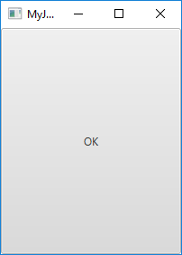
import javafx.application.Application; import javafx.stage.Stage; import javafx.scene.Scene; import javafx.scene.control.Button; public class MyJavaFX extends Application { @Override // Override the start method in the Application class public void start(Stage primaryStage) { // Create a button and place it in the scene Button btOK = new Button("OK"); Scene scene = new Scene(btOK, 200, 250); primaryStage.setTitle("MyJavaFX"); // Set the stage title primaryStage.setScene(scene); // Place the scene in the stage primaryStage.show(); // Display the stage } /** * The main method is only needed for the IDE with limited * JavaFX support. Not needed for running from the command line. */ public static void main(String[] args) { launch(args); } }

Slide 10
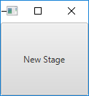
import javafx.application.Application;
import javafx.scene.Scene;
import javafx.scene.control.Button;
import javafx.stage.Stage;
public class MultipleStageDemo extends Application {
@Override // Override the start method in the Application class
public void start(Stage primaryStage) {
// Create a scene and place a button in the scene
Scene scene = new Scene(new Button("OK"), 200, 250);
primaryStage.setTitle("MyJavaFX"); // Set the stage title
primaryStage.setScene(scene); // Place the scene in the stage
primaryStage.show(); // Display the stage
Stage stage = new Stage(); // Create a new stage
stage.setTitle("Second Stage"); // Set the stage title
// Set a scene with a button in the stage
stage.setScene(new Scene(new Button("New Stage"), 100, 100));
stage.show(); // Display the stage
}
/**
* The main method is only needed for the IDE with limited
* JavaFX support. Not needed for running from the command line.
*/
public static void main(String[] args) {
launch(args);
}
}

Slide 11
☑ Check Point
How do you define a JavaFX main class?
What is the signature of the start method?
What is a stage? What is a primary stage? Is a primary stage automatically created?
How do you display a stage?
Can you prevent the user from resizing the stage?
Can you replace Application.launch(args) by launch(args)?
<--- ANSWER --->
You define a JavaFX main class by extending the Application class.
The signature of the start method is public void start(Stage primaryStage)
A stage is a window to holding a scene. An application may have multiple stages. The primary stage is automatically created when a JavaFX program is launched.
To display a stage, invoke its show() method.
You can prevent the user from resizing the stage by invoking stage.setResizable(false).
You can replace Application.launch(args) by launch(args), because the JavaFX main class is a subtype of Application.

Slide 12
☑ Check Point
Show the output of the following JavaFX program. import javafx.application.Application; import javafx.stage.Stage; public class Test extends Application { public Test() { System.out.println("Test constructor is invoked"); } @Override // Override the start method in the Application class public void start(Stage primaryStage) { System.out.println("start method is invoked"); } public static void main(String[] args) { System.out.println("launch application"); Application.launch(args); } }
<--- ANSWER --->
launch application Test constructor is invoked start method is invoked

Slide 13
Panes, UI Controls, and Shapes
Panes, UI controls, and shapes are subtypes of Node.
A node is a visual component such as a shape, an image view, a UI control, or a pane.
A shape refers to a text, line, circle, ellipse, rectangle, arc, polygon, polyline, etc.
A UI control refers to a label, button, check box, radio button, text field, text area, etc.
Panes are container classes for automatically laying out the nodes in a desired location and size.

Slide 14
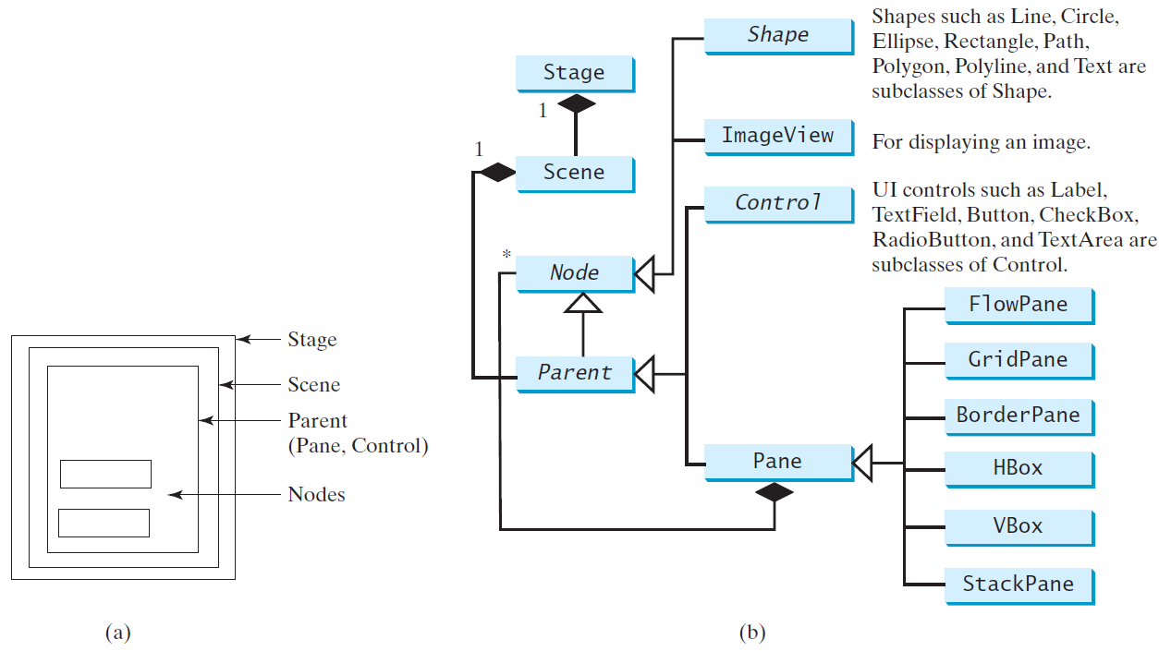
Panes, UI Controls, and Shapes
ButtonInPane
Run

Slide 15

import javafx.application.Application; import javafx.stage.Stage; import javafx.scene.Scene; import javafx.scene.layout.StackPane; import javafx.scene.control.Button;
public class ButtonInPane extends Application {
@Override // Override the start method in the Application class public void start(Stage primaryStage) { // Create a scene and place a button in the scene StackPane pane = new StackPane(); pane.getChildren().add(new Button("OK")); Scene scene = new Scene(pane, 200, 50); primaryStage.setTitle("Button in a pane"); // Set the stage title primaryStage.setScene(scene); // Place the scene in the stage primaryStage.show(); // Display the stage }
public static void main(String[] args) { launch(args); } }

Slide 16
Panes
The program creates a StackPane and adds a button as a child of the pane.
The getChildren() method returns an instance of javafx.collections.ObservableList.
ObservableList behaves very much like an ArrayList for storing a collection of elements.
Invoking add(e) adds an element to the list.
The StackPane places the nodes in the center of the pane on top of each other.

Slide 17
Display a Shape
This example displays a circle in the center of the pane.
The Java coordinate system is measured in pixels, with (0, 0) at its upper-left corner.
ShowCircle
Run

Slide 18
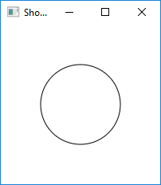
import javafx.application.Application; import javafx.stage.Stage; import javafx.scene.Scene; import javafx.scene.layout.Pane; import javafx.scene.shape.Circle; import javafx.scene.paint.Color;
public class ShowCircle extends Application { @Override // Override the start method in the Application class public void start(Stage primaryStage) { // Create a circle and set its properties Circle circle = new Circle(); circle.setCenterX(100); circle.setCenterY(100); circle.setRadius(50); circle.setStroke(Color.BLACK); circle.setFill(Color.WHITE); // Create a pane to hold the circle Pane pane = new Pane(); pane.getChildren().add(circle); // Create a scene and place it in the stage Scene scene = new Scene(pane, 200, 200); primaryStage.setTitle("ShowCircle"); // Set the stage title primaryStage.setScene(scene); // Place the scene in the stage primaryStage.show(); // Display the stage } /** * The main method is only needed for the IDE with limited * JavaFX support. Not needed for running from the command line. */ public static void main(String[] args) { launch(args); } }

Slide 19
☑ Check Point
How do you create a Scene object?
How do you set a scene in a stage?
How do you place a circle into a scene?
<--- ANSWER --->
To create a Scene, use new Scene(parent, width, height) or new Scene(parent).
To set a scene in a stage, invoke Stage's setScene(scene) method.
To place a circle to a scene, first place the circle into a pane, and then place the pane into the scene.

Slide 20
☑ Check Point
What is a pane?
What is a node?
How do you place a node in a pane?
Can you directly place a Shape or an ImageView into a Scene?
Can you directly place a Control or a Pane into a Scene?
<--- ANSWER --->
A pane is used to hold and organize nodes.
A node is a visual component that can be displayed.
You can place a node into a pane using the pane.getChildren().add(node).
You cannot directly place a Shape or an ImageView into a scene.
You can directly place a Control or a Pane into a scene when constructing a Scene using new Scene(Parent, width, height) or new Scene(Parent). Parent is the superclass for Control and Pane.

Slide 21
☑ Check Point
How do you create a Circle? How do you set its center location and radius? How do you set its stroke color and fill color?
How do you replace the following code using one statement? Pane pane = new Pane(); pane.getChildren().add(circle);
<--- ANSWER --->
You can create a Circle using its no-arg constructor and use its setCenterX, setCenterY methods to set its center location and use its setRadius to set its radius. To set the stroke color, use setStroke(color) method. To set the color, use the setFill(color) method.
Pane pane = new Pane(circle);

Slide 22
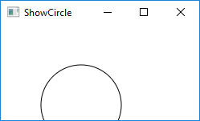
Binding Properties
JavaFX introduces a new concept called binding property that enables a target object to be bound to a source object.
If the value in the source object changes, the target property is also changed automatically.
The target object is simply called a binding object or a binding property.
The source object is called a bindable object or observable object.
Resizing the window in the previous example would cover the object:
Example: target.bind(source);

Slide 23
Binding Properties
In order to display the circle centered as the window resizes, the x- and y-coordinates of the circle center need to be reset to the center of the pane.
This can be done by binding the centerX with pane’s width/2 and centerY with pane’s height/2.
ShowCircleCentered
Run

Slide 24
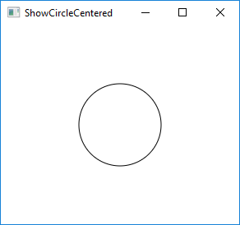
import javafx.application.Application; import javafx.stage.Stage; import javafx.scene.Scene; import javafx.scene.layout.Pane; import javafx.scene.shape.Circle; import javafx.scene.paint.Color; public class ShowCircleCentered extends Application { @Override // Override the start method in the Application class public void start(Stage primaryStage) { // Create a pane to hold the circle Pane pane = new Pane();
// Create a circle and set its properties Circle circle = new Circle();
circle.centerXProperty().bind(pane.widthProperty().divide(2));
circle.centerYProperty().bind(pane.heightProperty().divide(2));
circle.setRadius(50); circle.setStroke(Color.BLACK); circle.setFill(Color.WHITE); pane.getChildren().add(circle); // Add circle to the pane
// Create a scene and place it in the stage Scene scene = new Scene(pane, 200, 200); primaryStage.setTitle("ShowCircleCentered"); // Set the stage title primaryStage.setScene(scene); // Place the scene in the stage primaryStage.show(); // Display the stage } /** * The main method is only needed for the IDE with limited * JavaFX support. Not needed for running from the command line. */ public static void main(String[] args) { launch(args); } }
Notes:
- The bind method is defined in the javafx.beans.property.Property interface.
- A binding property is an instance of javafx.beans.property.Property.
- A source object is an instance of the javafx.beans.value.ObservableValue interface.
- An ObservableValue is an entity that wraps a value and allows to observe the value for changes.

Slide 25
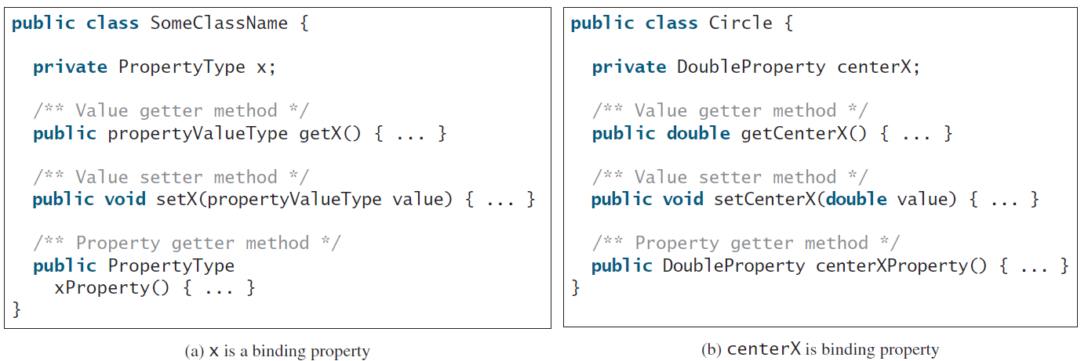
Binding Property: getter, setter, and property getter
(a) shows the convention for defining a binding property in a class and (b) shows a concrete example in which centerX is a binding property of the type DoubleProperty.

Slide 26
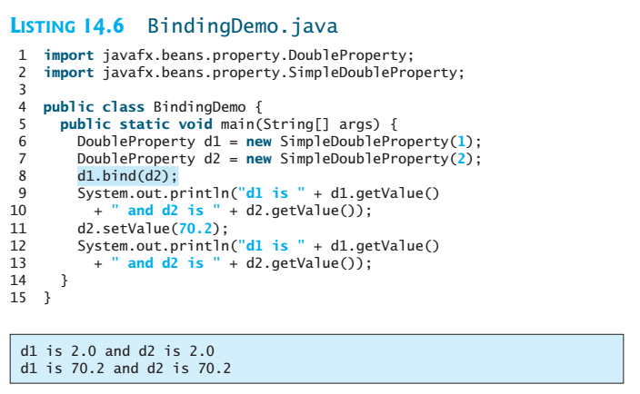
Unidirectional Binding
Bidirectional binding: If the target and source are both binding properties and observable properties, they can be bound bidirectionally using the bindBidirectional method. See BidirectionalBindingDemo.java

Slide 27
☑ Check Point
What is a binding property?
What interface defines a binding property? What interface defines a source object?
What are the binding object types for int, long, float, double, and boolean? Are Integer and Double binding properties? Can Integer and Double be used as source objects in a binding?
<--- ANSWER --->
A binding property is the one that binds with a source object. When the contents in the source changes, the binding property values change too.
A binding property is an instance of Property and a source object is an instance of ObservableValue.
The binding object types for int, long, float, double, and boolean are IntegerProperty, LongProperty, DoubleProperty, and BooleanProperty. Integer and Double are not subtypes of ObservableValue. Hence, they cannot be used as a source object in a binding.

Slide 28
☑ Check Point
Following the JavaFX binding property naming convention, for a binding property named age of the IntegerProperty type, what is its value getter method, value setter method, and property getter method?
Can you create an object of IntegerProperty using new IntegerProperty(3)? If not, what is the correct way to create it?
<--- ANSWER --->
The getter method is public int getAge(). The setter method is public void setAge(int age). The property getter is public IntegerProperty ageProperty().
No. IntegerProperty is an abstract class. You have to use new SimpleIntegerProperty(4) to create an instance of IntegerProperty.

Slide 29
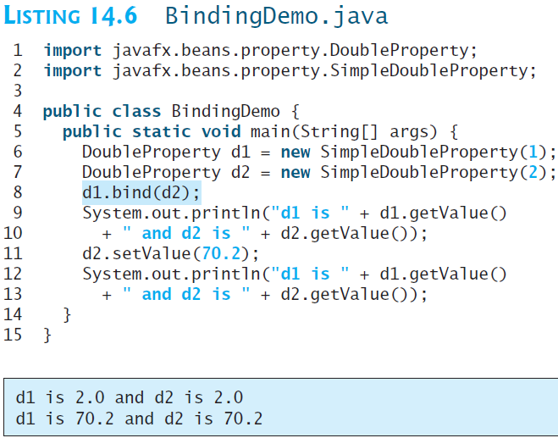
☑ Check Point
What will the output if line 8 is replaced by d1.bind(d2.multiply(2)) in Listing 14.6?
What will the output if line 8 is replaced by d1.bind(d2.add(2)) in Listing 14.6?
<--- ANSWER --->
d1 is 2.0 and d2 is 2.0 d1 is 140.4 and d2 is 70.2
d1 is 2.0 and d2 is 2.0 d1 is 72.4 and d2 is 70.2

Slide 30
☑ Check Point
What is a unidirectional binding and what is bidirectional binding?
Are all binding properties capable of bidirectional binding?
Write a statement to bind property d1 with property d2 bidirectionally.
<--- ANSWER --->
A unidirectional binding binds a target with a source. A bidirectional binding binds two objects together. Changes in one object affects the other.
Not all binding properties can be bidirectional.
The statement to bind d1 with d2 is d1.bindBidirectional(d2).

Slide 31
Common Properties and Methods for Nodes
The abstract Node class defines many properties and methods that are common to all nodes.
Two common properties:
style: set a JavaFX CSS style
rotate: Rotate a node

Slide 32
Common Properties and Methods for Nodes
JavaFX style properties are similar to cascading style sheets (CSS) used to specify the styles for HTML elements in a Web page.
So, the style properties in JavaFX are called JavaFX CSS.
In JavaFX, a style property is defined with a prefix -fx-
Each node has its own style properties.
You can find these properties from http://docs.oracle.com/javafx/2/api/javafx/scene/doc-files/cssref.html

Slide 33
Common Properties and Methods for Nodes
The syntax for setting a style is styleName:value.
Multiple style properties for a node can be set together separated by semicolon (;).
For example, the following statement circle.setStyle("-fx-stroke: black; -fx-fill: red;"); sets two JavaFX CSS properties for a circle.
rotate: Rotate a node
NodeStyleRotateDemo
Run

Slide 34
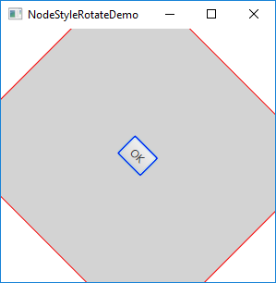
import javafx.application.Application; import javafx.stage.Stage; import javafx.scene.Scene; import javafx.scene.layout.StackPane; import javafx.scene.control.Button; public class NodeStyleRotateDemo extends Application { @Override public void start(Stage primaryStage) { StackPane pane = new StackPane(); Button btOK = new Button("OK"); btOK.setStyle("-fx-border-color: blue;"); pane.getChildren().add(btOK); pane.setRotate(45); pane.setStyle("-fx-border-color: red; -fx-background-color: lightgray;"); Scene scene = new Scene(pane, 200, 250); primaryStage.setTitle("NodeStyleRotateDemo"); // Set the stage title primaryStage.setScene(scene); // Place the scene in the stage primaryStage.show(); // Display the stage } /** * The main method is only needed for the IDE with limited * JavaFX support. Not needed for running from the command line. */ public static void main(String[] args) { launch(args); } }
Notes:
- The rotate on a pane causes all its containing nodes rotated too.

Slide 35
public class NodeStyleRotateDemo extends Application { @Override public void start(Stage primaryStage) { StackPane pane = new StackPane(); …
}
/* The StackPane layout pane places all of the nodes within a single stack with each new node added on top of the previous node. This layout model provides an easy way to overlay text on a shape or image and to overlap common shapes to create a complex shape. */

Slide 36
☑ Check Point
How do you set a style of a node with border color red?
Modify the code to set the text color for the button to red.
Can you rotate a pane, a text, or a button?
Modify the code to rotate the button 15 degrees counterclockwise?
How do you test if a point is inside a node?
How do you scale up or down a node?
<--- ANSWER --->
node.setStyle("-fx-border: red");
text.setStyle("-fx-fill: red");
Yes.
button.setRotate(-15);
node.contains(x, y);
node.setScaleX(2.0); // Scale x-coordinates up node.setScaleX(0.2); // Scale x-coordinates down

Slide 37
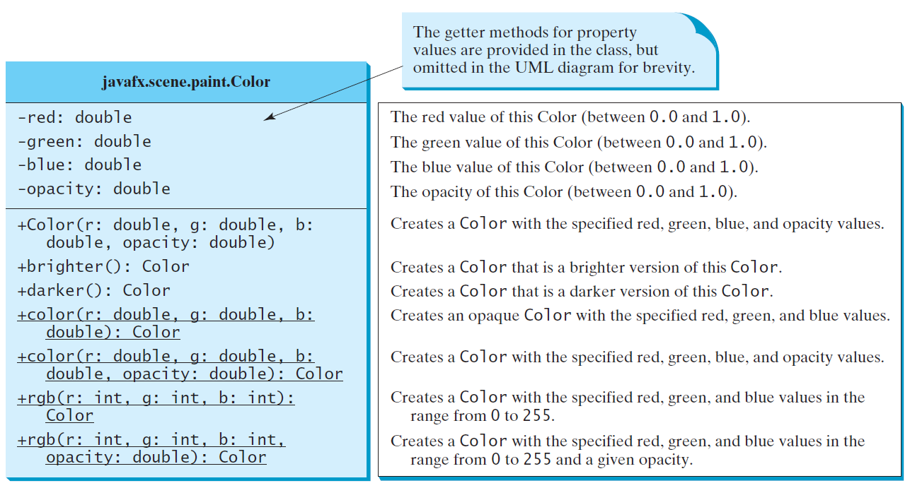
Helper Classes: The Color Class

Slide 38
☑ Check Point
How do you create a color?
What is wrong about creating a Color using new Color(1.2, 2.3, 3.5, 4)?
Which of two colors is darker, new Color(0, 0, 0, 1) or new Color(1, 1, 1, 1)?
Does invoking c.darker() change the color value in c?
How do you create a Color object with a random color?
How do you set a circle object c with blue fill color using the setFill method and using the setStyle method?
<--- ANSWER --->
You can use the Color constructor or static methods in the Color class to create Color objects.
new Color(1.2, 2.3, 3.5, 4) is wrong because the parameter values must be between 0 and 1.
new Color(0, 0, 0, 1) is darker than new Color(1, 1, 1, 1).
Invoking c.darker() returns a new Color. Color is immutable.
new Color(Math.random(), Math.random(), Math.random(), 1)
c.setFill(Color.BLUE) c.setStyle("-fx-fill: blue")

Slide 39
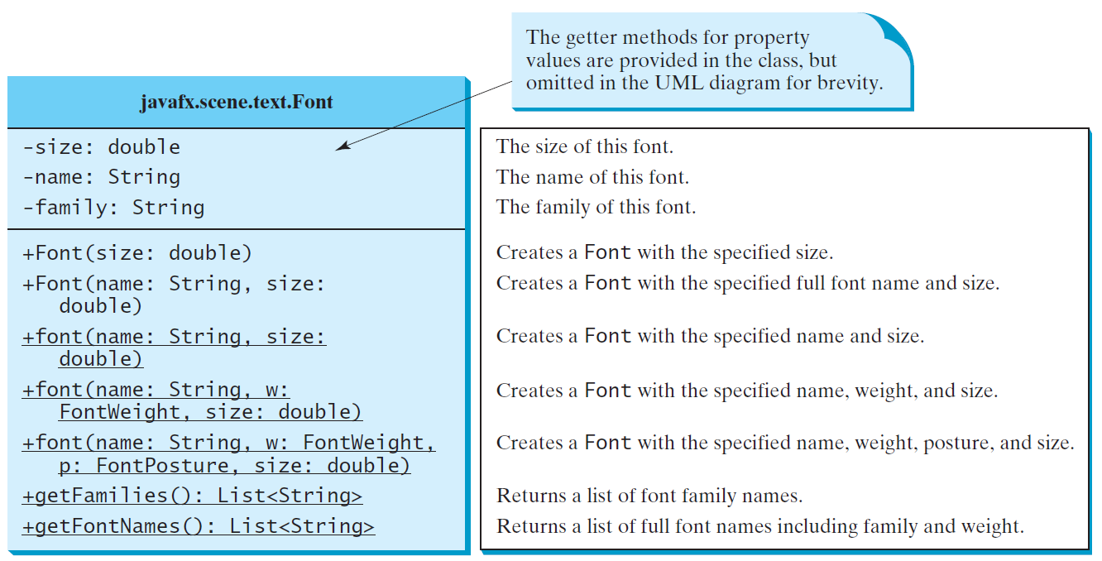
Helper Classes: The Font Class
FontDemo
Run

Slide 40
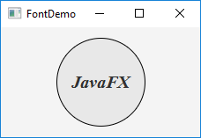
import javafx.application.Application;
import javafx.scene.Scene;
import javafx.scene.layout.*;
import javafx.scene.paint.Color;
import javafx.scene.shape.Circle;
import javafx.scene.text.*;
import javafx.scene.control.*;
import javafx.stage.Stage;
public class FontDemo extends Application {
@Override // Override the start method in the Application class
public void start(Stage primaryStage) {
// Create a pane to hold the circle
Pane pane = new StackPane();
// Create a circle and set its properties
Circle circle = new Circle();
circle.setRadius(50);
circle.setStroke(Color.BLACK);
circle.setFill(new Color(0.5, 0.5, 0.5, 0.1));
pane.getChildren().add(circle); // Add circle to the pane
// Create a label and set its properties
Label label = new Label("JavaFX");
label.setFont(Font.font("Times New Roman", FontWeight.BOLD, FontPosture.ITALIC, 20));
pane.getChildren().add(label);
// Create a scene and place it in the stage
Scene scene = new Scene(pane);
primaryStage.setTitle("FontDemo"); // Set the stage title
primaryStage.setScene(scene); // Place the scene in the stage
primaryStage.show(); // Display the stage
}
public static void main(String[] args) {
launch(args);
}
}

Slide 41
☑ Check Point
How do you create a Font object with font name Courier, size 20, and weight bold?
How do you find all available fonts on your system?
<--- ANSWER --->
new Font("Courier", Weight.BOLD, 20)
Use Font.getFontNames() to return a list of strings for font names.

Slide 42
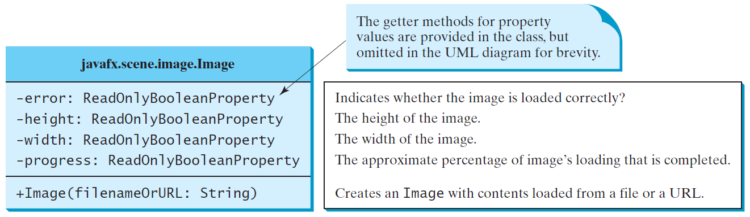
The Image Class

Slide 43
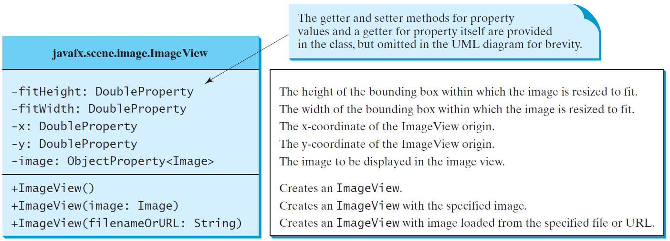
The ImageView Class
ShowImage
Run

Slide 44
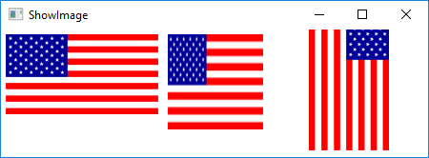
import javafx.application.Application; import javafx.stage.Stage; import javafx.scene.Scene; import javafx.scene.layout.Pane; import javafx.scene.layout.HBox; import javafx.scene.image.Image; import javafx.scene.image.ImageView; import javafx.geometry.Insets; public class ShowImage extends Application { @Override public void start(Stage primaryStage) { // Create a pane to hold the image views Pane pane = new HBox(10); pane.setPadding(new Insets(5, 5, 5, 5)); Image image = new Image("image/us.gif"); pane.getChildren().add(new ImageView(image)); ImageView imageView2 = new ImageView(image); imageView2.setFitHeight(100); imageView2.setFitWidth(100); pane.getChildren().add(imageView2);
ImageView imageView3 = new ImageView(image);
imageView3.setRotate(90);
pane.getChildren().add(imageView3); Scene scene = new Scene(pane); primaryStage.setTitle("ShowImage"); primaryStage.setScene(scene); primaryStage.show(); } public static void main(String[] args) { launch(args); } }

Slide 45
☑ Check Point
How do you create an Image from a URL or a filename?
How do you create an ImageView from an Image, or directly from a file or a URL?
Can you set an Image to multiple ImageView? Can you display the same ImageView multiple times?
<--- ANSWER --->
Use new Image(filename) or new Image(url)
Use new ImageView(image)
You can set an Image to multiple ImageView, but you cannot display one ImageView multiple times.

Slide 46
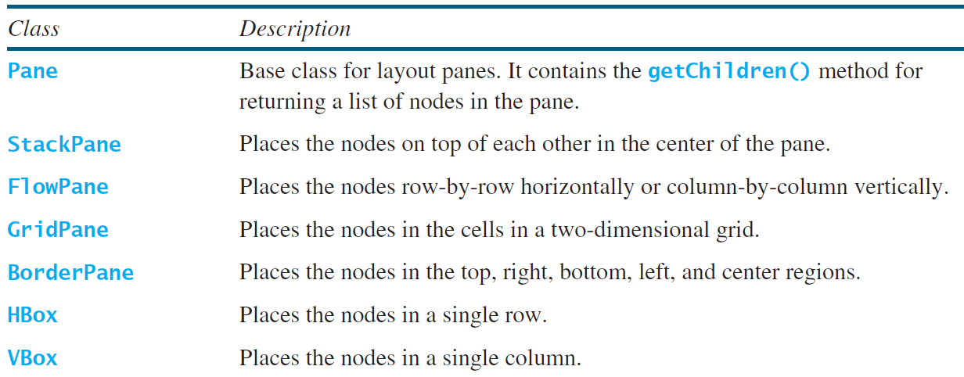
Layout Panes
JavaFX provides many types of panes for organizing nodes in a container.

Slide 47
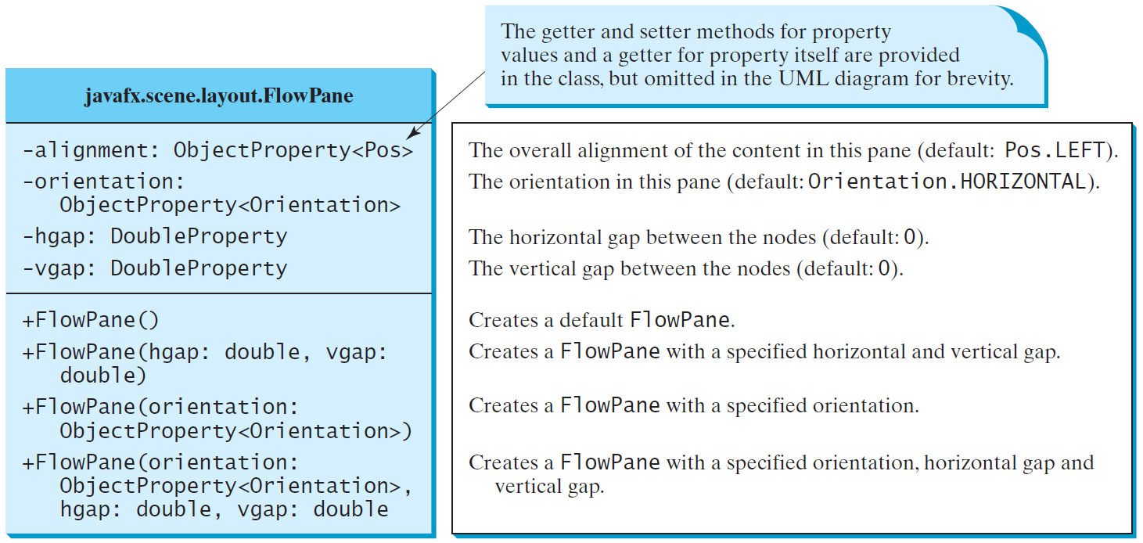
FlowPane
Places the nodes row-by-row horizontally or column-by-column vertically.

Slide 48
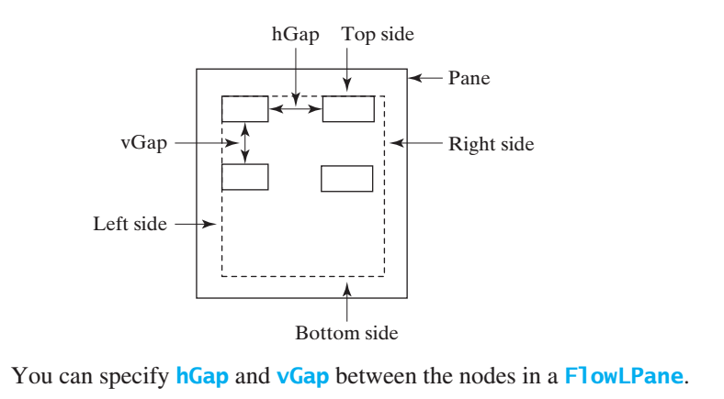
FlowPane
ShowFlowPane
Run

Slide 49
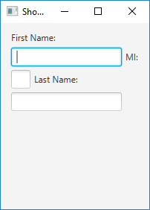

import javafx.application.Application; import javafx.stage.Stage; import javafx.scene.Scene; import javafx.scene.layout.FlowPane; import javafx.scene.control.Label; import javafx.scene.control.TextField; import javafx.geometry.Insets; public class ShowFlowPane extends Application { @Override public void start(Stage primaryStage) { FlowPane pane = new FlowPane(); pane.setPadding(new Insets(11, 12, 13, 14)); pane.setHgap(5); pane.setVgap(5); // Place nodes in the pane pane.getChildren().addAll(new Label("First Name:"), new TextField(), new Label("MI:")); TextField tfMi = new TextField(); tfMi.setPrefColumnCount(1); pane.getChildren().addAll(tfMi, new Label("Last Name:"), new TextField()); // Create a scene and place it in the stage Scene scene = new Scene(pane, 210, 150); primaryStage.setTitle("ShowFlowPane"); primaryStage.setScene(scene); // Place the scene in the stage primaryStage.show(); // Display the stage } public static void main(String[] args) { launch(args); } }
Notes:
- Note that if you resize the window, the nodes are automatically rearranged to fit in the pane.

Slide 50
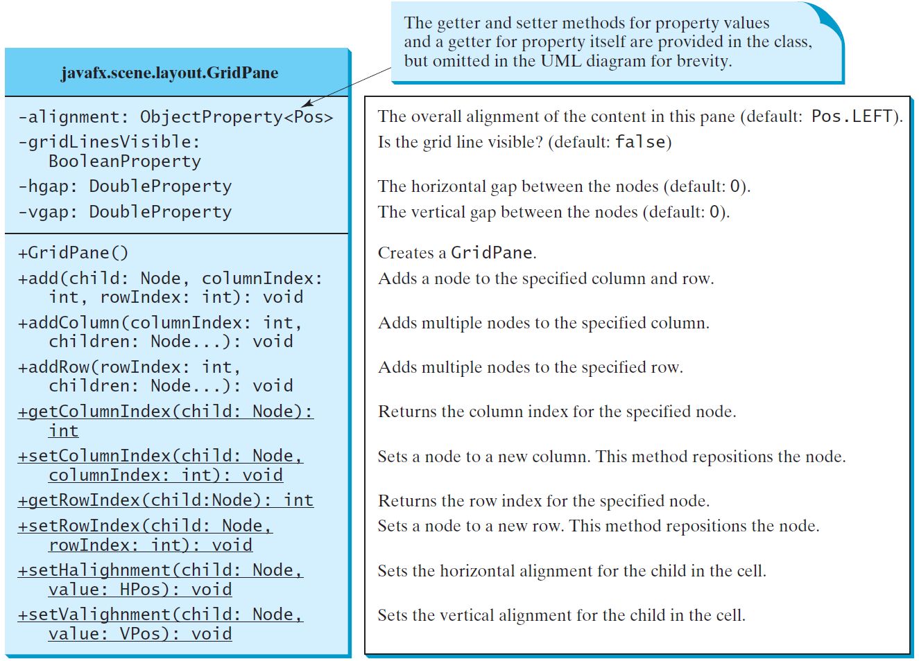
GridPane
Places the nodes in the cells in a two-dimensional grid
ShowGridPane
Run

Slide 51
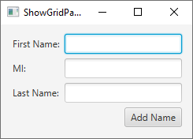
import javafx.application.Application; import javafx.stage.Stage; import javafx.scene.Scene; import javafx.scene.layout.GridPane; import javafx.scene.control.*; import javafx.geometry.*;
public class ShowGridPane extends Application { @Override public void start(Stage primaryStage) { // Create a pane and set its properties GridPane pane = new GridPane(); pane.setAlignment(Pos.CENTER);
pane.setPadding(new Insets(11.5, 12.5, 13.5, 14.5));
pane.setHgap(5.5); pane.setVgap(5.5);
// Place nodes in the pane at positions column,row pane.add(new Label("First Name:"), 0, 0); pane.add(new TextField(), 1, 0); pane.add(new Label("MI:"), 0, 1); pane.add(new TextField(), 1, 1); pane.add(new Label("Last Name:"), 0, 2); pane.add(new TextField(), 1, 2); Button btAdd = new Button("Add Name"); pane.add(btAdd, 1, 3); GridPane.setHalignment(btAdd, HPos.RIGHT);
// Create a scene and place it in the stage Scene scene = new Scene(pane); primaryStage.setTitle("ShowGridPane"); primaryStage.setScene(scene); primaryStage.show();
} public static void main(String[] args) {
launch(args);
} }

Slide 52
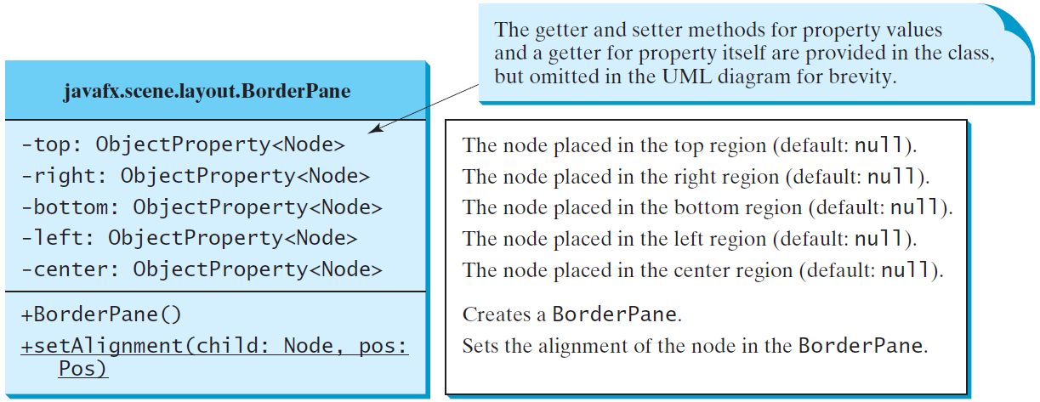
BorderPane
Places the nodes in the top, right, bottom, left, and center regions.
ShowBorderPane
Run

Slide 53
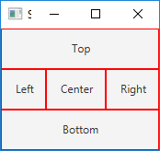
import javafx.application.Application; import javafx.stage.Stage; import javafx.scene.Scene; import javafx.scene.layout.BorderPane; import javafx.scene.layout.StackPane; import javafx.scene.control.Label; import javafx.geometry.Insets; public class ShowBorderPane extends Application { @Override public void start(Stage primaryStage) { BorderPane pane = new BorderPane(); pane.setTop(new CustomPane("Top")); pane.setRight(new CustomPane("Right")); pane.setBottom(new CustomPane("Bottom")); pane.setLeft(new CustomPane("Left")); pane.setCenter(new CustomPane("Center")); Scene scene = new Scene(pane);
primaryStage.setTitle("ShowBorderPane"); // Set the stage title primaryStage.setScene(scene); primaryStage.show(); } /* main method defined here */ } class CustomPane extends StackPane { public CustomPane(String title) { getChildren().add(new Label(title)); setStyle("-fx-border-color: red"); setPadding(new Insets(11.5, 12.5, 13.5, 14.5)); }}

Slide 54
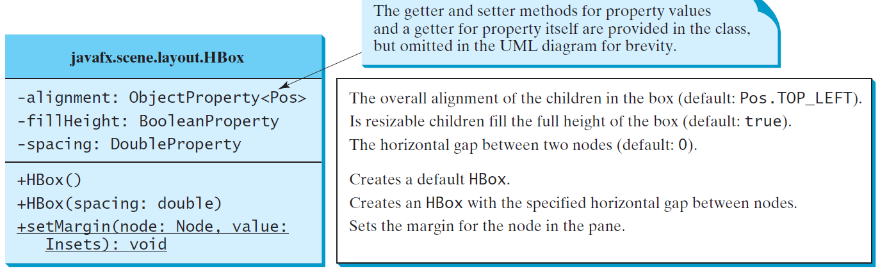
HBox
Places the nodes in a single row.

Slide 55
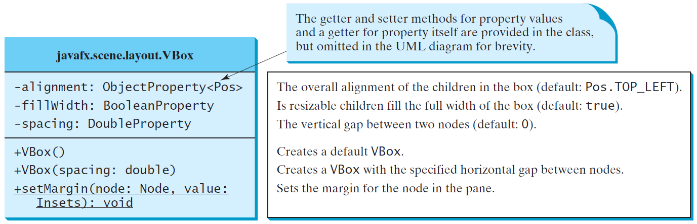
VBox
Places the nodes in a single column
ShowHBoxVBox
Run

Slide 56
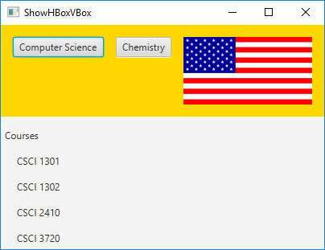
import javafx.application.Application;
import javafx.geometry.Insets;
import javafx.scene.Scene;
import javafx.scene.control.*;
import javafx.scene.layout.*;
import javafx.stage.Stage;
import javafx.scene.image.*;
public class ShowHBoxVBox extends Application {
@Override // Override the start method in the Application
public void start(Stage primaryStage) {
// Create a border pane
BorderPane pane = new BorderPane();
// Place nodes in the pane
pane.setTop(getHBox());
pane.setLeft(getVBox());
// Create a scene and place it in the stage
Scene scene = new Scene(pane);
primaryStage.setTitle("ShowHBoxVBox");
primaryStage.setScene(scene);
primaryStage.show();
}
private HBox getHBox() {
HBox hBox = new HBox(15);
hBox.setPadding(new Insets(15, 15, 15, 15));
hBox.setStyle("-fx-background-color: gold");
hBox.getChildren().add(new Button("Computer Science"));
hBox.getChildren().add(new Button("Chemistry"));
ImageView imageView = new ImageView(new Image("image/us.gif"));
hBox.getChildren().add(imageView);
return hBox;
}
private VBox getVBox() {
VBox vBox = new VBox(15);
vBox.setPadding(new Insets(15, 5, 5, 5));
vBox.getChildren().add(new Label("Courses"));
Label[] courses = {new Label("CSCI 1301"), new Label("CSCI 1302"), new Label("CSCI 2410"), new Label("CSCI 3720")};
for (Label course: courses) {
VBox.setMargin(course, new Insets(0, 0, 0, 15));
vBox.getChildren().add(course);
}
return vBox;
}
public static void main(String[] args) {
launch(args);
}
}

Slide 57
☑ Check Point
How do you add a node to a Pane, StackPane, FlowPane, GridPane, BorderPane, HBox, and VBox?
How do you remove a node from these panes?
How do you set the alignment to right for nodes in a FlowPane, GridPane, HBox, and VBox?
How do you set the horizontal gap and vertical hap between nodes in 8 pixels in a FlowPane and GridPane and set spacing in 7 pixels in an HBox and VBox?
How do you get the column and row index of a node in a GridPane?
How do you reposition a node in a GridPane?
What are the differences between a FlowPane and an HBox or a VBox?
<--- ANSWER --->
To add a node to a Pane, StackPane, FlowPane, HBox, and VBox, use pane.getChildren().add(node). To add node to a BorderPane, use the setTop, setBottom, setLeft, setRight, and setCenter methods.
To remove a node from these panes, use pane.getChildren().remove(node).
pane.setAlignment(Pos.RIGHT)
For a FlowPane and a GridPane, pane.setHGap(8) and pane.setVGap(8). For an HBox and VBox, use pane.setSpacing(7).
pane.getRowIndex(node) and pane.getColumnIndex(node).
To reposition a node in a GridPane, use pane.setRowIndex(node, rowIndex) and pane.setColumnIndex(node, columnIndex).
FlowPane can have multiple rows and columns. The nodes in a FlowPane can be placed horizontally or vertically. An HBox can have only one row and an VBox can have only one column.

Slide 58
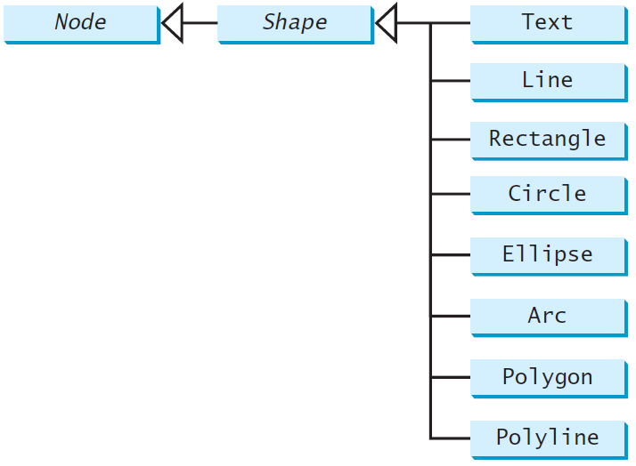
Shapes
JavaFX provides many shape classes for drawing texts, lines, circles, rectangles, ellipses, arcs, polygons, and polylines.

Slide 59
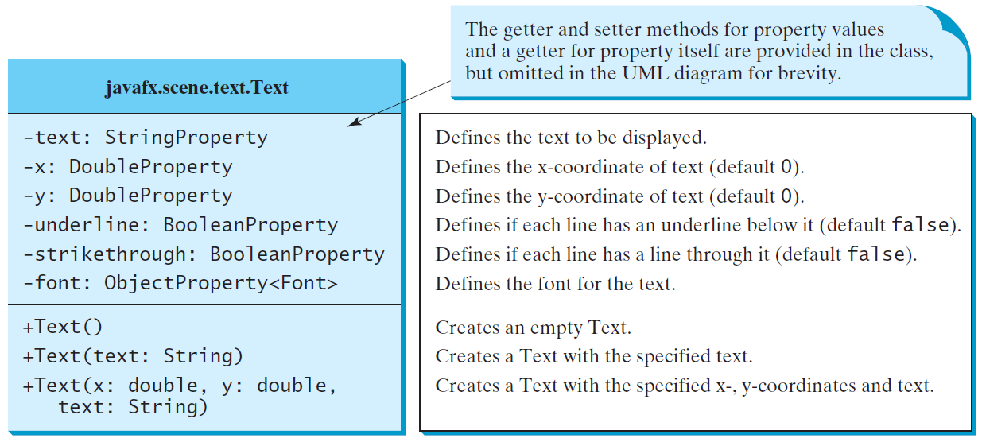
Text
Text defines a node for displaying a text at a starting point (x, y)

Slide 60
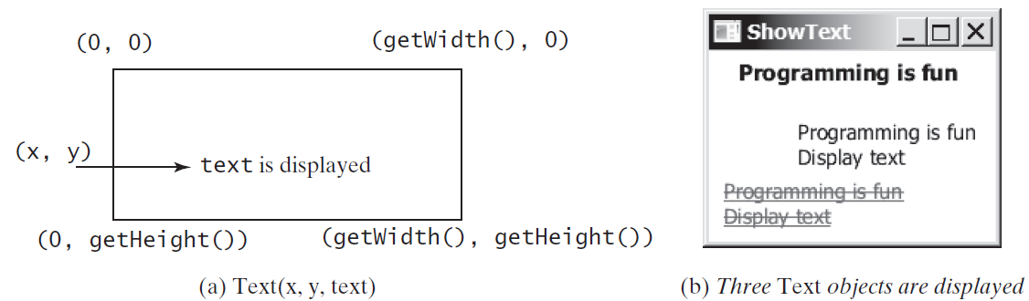
Text Example
ShowText
Run

Slide 61
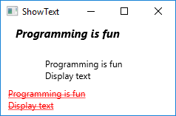
import javafx.application.Application; import javafx.stage.Stage; import javafx.scene.Scene; import javafx.scene.layout.Pane; import javafx.scene.paint.Color; import javafx.geometry.Insets; import javafx.scene.text.Text; import javafx.scene.text.Font; import javafx.scene.text.FontWeight; import javafx.scene.text.FontPosture; public class ShowText extends Application { @Override public void start(Stage primaryStage) { Pane pane = new Pane(); pane.setPadding(new Insets(5, 5, 5, 5)); Text text1 = new Text(20, 20, "Programming is fun"); text1.setFont(Font.font("Courier", FontWeight.BOLD, FontPosture.ITALIC, 15)); pane.getChildren().add(text1); Text text2 = new Text(60, 60, "Programming is fun\nDisplay text"); pane.getChildren().add(text2); Text text3 = new Text(10, 100, "Programming is fun\nDisplay text"); text3.setFill(Color.RED); text3.setUnderline(true); text3.setStrikethrough(true); pane.getChildren().add(text3); Scene scene = new Scene(pane);
primaryStage.setTitle("ShowText"); primaryStage.setScene(scene); primaryStage.show(); } ... }

Slide 62
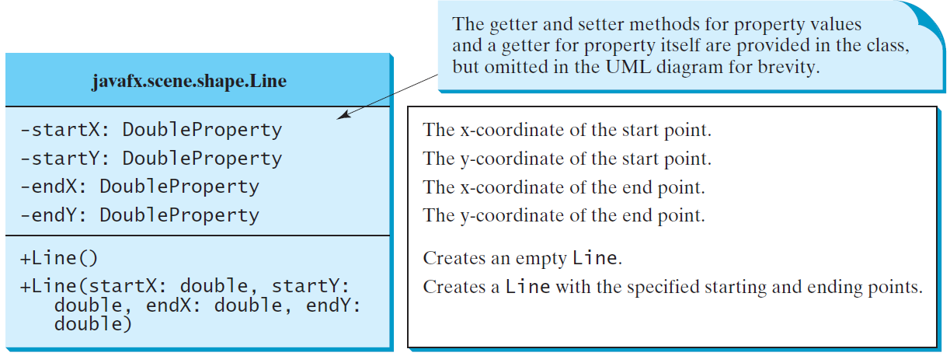
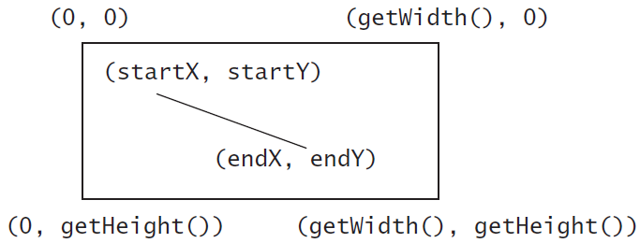
Line
A line connects two points with four parameters startX, startY, endX, and endY.
ShowLine
Run

Slide 63
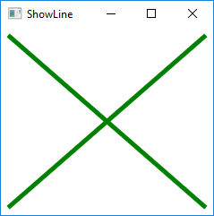
import javafx.application.Application;
import javafx.scene.Scene;
import javafx.scene.layout.Pane;
import javafx.scene.paint.Color;
import javafx.stage.Stage;
import javafx.scene.shape.Line;
public class ShowLine extends Application {
@Override // Override the start method in the Application class
public void start(Stage primaryStage) {
// Create a scene and place it in the stage
Scene scene = new Scene(new LinePane(), 200, 200);
primaryStage.setTitle("ShowLine"); // Set the stage title
primaryStage.setScene(scene); // Place the scene in the stage
primaryStage.show(); // Display the stage
}
public static void main(String[] args) {
launch(args);
}
}
class LinePane extends Pane {
public LinePane() {
Line line1 = new Line(10, 10, 10, 10);
line1.endXProperty().bind(widthProperty().subtract(10));
line1.endYProperty().bind(heightProperty().subtract(10));
line1.setStrokeWidth(5);
line1.setStroke(Color.GREEN);
getChildren().add(line1);
Line line2 = new Line(10, 10, 10, 10);
line2.startXProperty().bind(widthProperty().subtract(10));
line2.endYProperty().bind(heightProperty().subtract(10));
line2.setStrokeWidth(5);
line2.setStroke(Color.GREEN);
getChildren().add(line2);
}
}

Slide 64
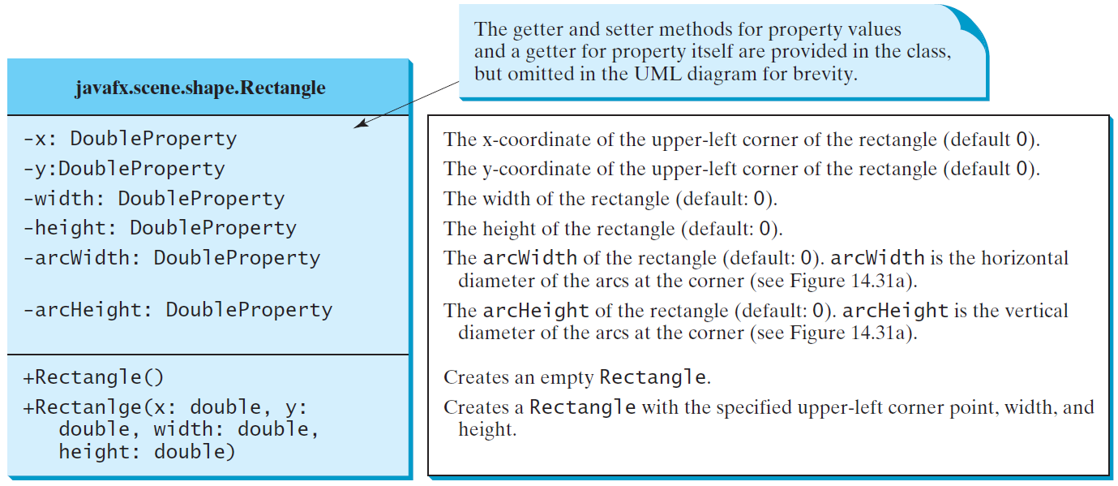
Rectangle

Slide 65
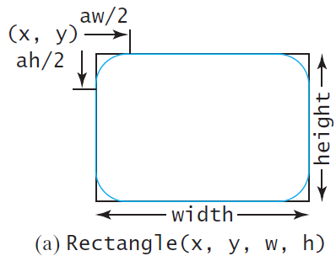
Rectangle Example
The rectangle’s upper-left corner point is at (x, y) aw (arcWidth) is the horizontal diameter of the arcs at the corner ah (arcHeight) is the vertical diameter of the arcs at the corner.
ShowRectangle
Run

Slide 66
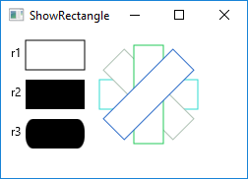
public class ShowRectangle extends Application {
@Override // Override the start method in the Application class
public void start(Stage primaryStage) {
// Create a pane
Pane pane = new Pane();
// Create rectangles and add to pane
Rectangle r1 = new Rectangle(25, 10, 60, 30);
r1.setStroke(Color.BLACK);
r1.setFill(Color.WHITE);
pane.getChildren().add(new Text(10, 27, "r1"));
pane.getChildren().add(r1);
Rectangle r2 = new Rectangle(25, 50, 60, 30);
pane.getChildren().add(new Text(10, 67, "r2"));
pane.getChildren().add(r2);
Rectangle r3 = new Rectangle(25, 90, 60, 30);
r3.setArcWidth(15);
r3.setArcHeight(25);
pane.getChildren().add(new Text(10, 107, "r3"));
pane.getChildren().add(r3);
for (int i = 0; i < 4; i++) {
Rectangle r = new Rectangle(100, 50, 100, 30);
r.setRotate(i * 360 / 8);
r.setStroke(Color.color(Math.random(), Math.random(), Math.random()));
r.setFill(Color.WHITE);
pane.getChildren().add(r);
}
// Create a scene and place it in the stage
Scene scene = new Scene(pane, 250, 150);
primaryStage.setTitle("ShowRectangle"); // Set the stage title
primaryStage.setScene(scene); // Place the scene in the stage
primaryStage.show(); // Display the stage
}
. . .
}

Slide 67
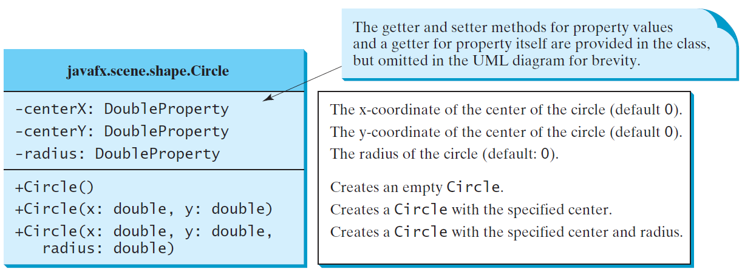
Circle

Slide 68
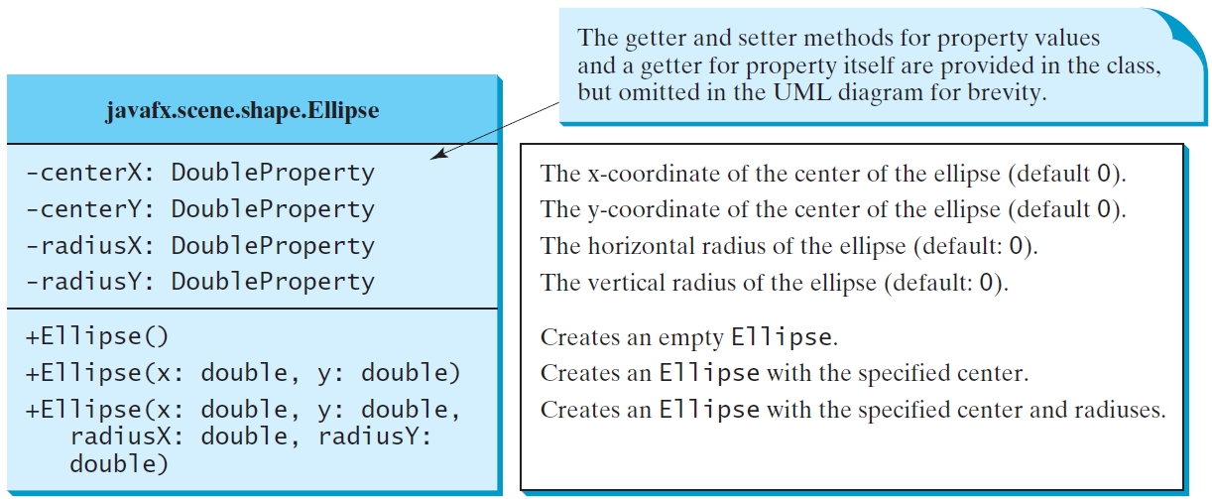
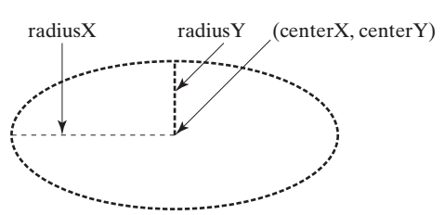
Ellipse
ShowEllipse
Run

Slide 69
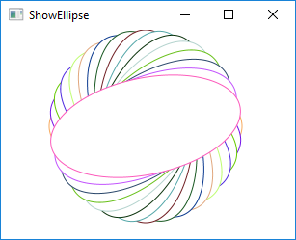
public class ShowEllipse extends Application {
@Override // Override the start method in the Application class
public void start(Stage primaryStage) {
// Create a pane
Pane pane = new Pane();
for (int i = 0; i < 16; i++) {
// Create an ellipse and add it to pane
Ellipse e1 = new Ellipse(150, 100, 100, 50);
e1.setStroke(Color.color(Math.random(), Math.random(),
Math.random()));
e1.setFill(Color.WHITE);
e1.setRotate(i * 180 / 16);
pane.getChildren().add(e1);
}
// Create a scene and place it in the stage
Scene scene = new Scene(pane, 300, 200);
primaryStage.setTitle("ShowEllipse"); // Set the stage title
primaryStage.setScene(scene); // Place the scene in the stage
primaryStage.show(); // Display the stage
}
/**
* The main method is only needed for the IDE with limited
* JavaFX support. Not needed for running from the command line.
*/
public static void main(String[] args) {
launch(args);
}
}

Slide 70
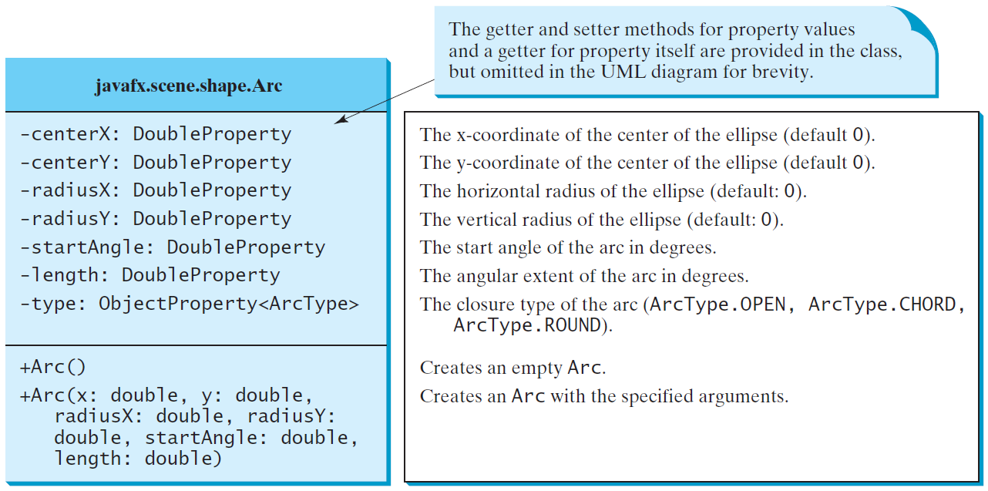
Arc

Slide 71
Arc Examples
ShowArc
Run

Slide 72
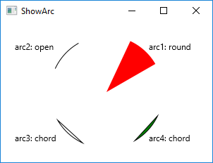
public class ShowArc extends Application {
@Override // Override the start method in the Application class
public void start(Stage primaryStage) {
// Create a pane
Pane pane = new Pane();
Arc arc1 = new Arc(150, 100, 80, 80, 30, 35); // Create an arc
arc1.setFill(Color.RED); // Set fill color
arc1.setType(ArcType.ROUND); // Set arc type
pane.getChildren().add(new Text(210, 40, "arc1: round"));
pane.getChildren().add(arc1); // Add arc to pane
Arc arc2 = new Arc(150, 100, 80, 80, 30 + 90, 35);
arc2.setFill(Color.WHITE);
arc2.setType(ArcType.OPEN);
arc2.setStroke(Color.BLACK);
pane.getChildren().add(new Text(20, 40, "arc2: open"));
pane.getChildren().add(arc2);
Arc arc3 = new Arc(150, 100, 80, 80, 30 + 180, 35);
arc3.setFill(Color.WHITE);
arc3.setType(ArcType.CHORD);
arc3.setStroke(Color.BLACK);
pane.getChildren().add(new Text(20, 170, "arc3: chord"));
pane.getChildren().add(arc3);
Arc arc4 = new Arc(150, 100, 80, 80, 30 + 270, 35);
arc4.setFill(Color.GREEN);
arc4.setType(ArcType.CHORD);
arc4.setStroke(Color.BLACK);
pane.getChildren().add(new Text(210, 170, "arc4: chord"));
pane.getChildren().add(arc4);
// Create a scene and place it in the stage
Scene scene = new Scene(pane, 300, 200);
primaryStage.setTitle("ShowArc"); // Set the stage title
primaryStage.setScene(scene); // Place the scene in the stage
primaryStage.show(); // Display the stage
}
…
}

Slide 73
Polygon and Polyline
The Polygon class defines a polygon that connects a sequence of points. The Polyline class is similar to the Polygon class except that the Polyline class is not automatically closed.

Slide 74
Polygon
ShowPolygon
Run

Slide 75
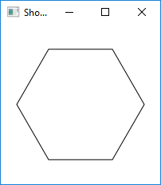
import javafx.application.Application;
import javafx.collections.ObservableList;
import javafx.scene.Scene;
import javafx.scene.layout.Pane;
import javafx.scene.paint.Color;
import javafx.stage.Stage;
import javafx.scene.shape.Polygon;
public class ShowPolygon extends Application {
@Override // Override the start method in the Application class
public void start(Stage primaryStage) {
// Create a pane, a polygon, and place polygon to pane
Pane pane = new Pane();
Polygon polygon = new Polygon();
pane.getChildren().add(polygon);
polygon.setFill(Color.WHITE);
polygon.setStroke(Color.BLACK);
ObservableList<Double> list = polygon.getPoints();
final double WIDTH = 200, HEIGHT = 200;
double centerX = WIDTH / 2, centerY = HEIGHT / 2;
double radius = Math.min(WIDTH, HEIGHT) * 0.4;
// Add points to the polygon list
for (int i = 0; i < 6; i++) {
list.add(centerX + radius * Math.cos(2 * i * Math.PI / 6));
list.add(centerY - radius * Math.sin(2 * i * Math.PI / 6));
}
// Create a scene and place it in the stage
Scene scene = new Scene(pane, WIDTH, HEIGHT);
primaryStage.setTitle("ShowPolygon"); // Set the stage title
primaryStage.setScene(scene); // Place the scene in the stage
primaryStage.show(); // Display the stage
}
. . .
}

Slide 76
☑ Check Point
How do you display a text, line, rectangle, circle, ellipse, arc, polygon, and polyline?
Write code fragments to display a string rotated 45 degrees in the center of the pane.
Write code fragments to display a thick line of 10 pixels from (10, 10) to (70, 30).
Write code fragments to fill red color in a rectangle of width 100 and height 50 with the upper-left corner at (10, 10).
Write code fragments to display a round-cornered rectangle with width 100, height 200with the upper-left corner at (10, 10), corner horizontal diameter 40, and corner vertical diameter 20.
Write code fragments to display an ellipse with horizontal radius 50 and vertical radius 100.
Write code fragments to display the outline of the upper half of a circle with radius 50.
<--- ANSWER --->
To display a text, line, rectangle, circle, ellipse, arc, polygon, and polyline, create an instance of the Text, Line, Rectangle, Circle, Ellipse, Arc, Polygon, and Polyline and add it to a pane and place the pane into a scene.
Text text = new Text("Welcome"); StackPane pane = new StackPane(); pane.getChildren().add(text); text.setRotate(15);
Line line = new Line(10, 10, 70, 30); line.setStrokeWidth(10);
Rectangle rectangle = new Rectangle(10, 10, 100, 50); rectangle.setFill(Color.RED);
Rectangle rectangle = new Rectangle(10, 10, 100, 200); rectangle.setArcWidth(40); rectangle.setArcHeight(20);
Ellipse ellipse = new Ellipse(); ellipse.setRadiusX(50); ellipse.setRadiusY(100);
Arc arc = new Arc(); arc.setRadiusX(50); arc.setRadiusY(50); arc.setFill(null); arc.setStartAngle(0); arc.setLength(180); arc.setType(ArcType.OPEN);

Slide 77
☑ Check Point
Write code fragments to display the lower half of a circle with radius 50 filled with the red color.
Write code fragments to display a polygon connecting the following points: (20, 40), (30, 50), (40, 90), (90, 10), (10, 30), and fill the polygon with green color.
Write code fragments to display a polyline connecting the following points: (20, 40), (30, 50), (40, 90), (90, 10), (10, 30).
What is wrong in the following code? public void start(Stage primaryStage) { // Create a polygon and place it in the scene Scene scene = new Scene(new Polygon(), 400, 400); primaryStage.setScene(scene); // Place the scene in the stage primaryStage.show(); // Display the stage }
<--- ANSWER --->
Arc arc = new Arc(); arc.setRadiusX(50); arc.setRadiusY(50); arc.setStartAngle(180); arc.setLength(180); arc.setFill(Color.RED); arc.setType(ArcType.ROUND);
Polygon p = new Polygon(); g.getPoints().addAll(20.0, 40.0, 30.0, 50.0, 40.0, 90.0, 90.0, 10.0, 10.0, 30.0); p.setFill(Color.GREEN);
Polyline p = new Polyline(); p.getPoints().addAll(20.0, 40.0, 30.0, 50.0, 40.0, 90.0, 90.0, 10.0, 10.0, 30.0);
Polygon is a Shape, which cannot be directly added to a scene. You have to place a shape into a pane and add the pane into the scene.

Slide 78
Case Study: The ClockPane Class
This case study develops a class that displays a clock on a pane.
ClockPane

Slide 79
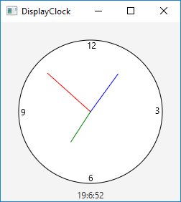
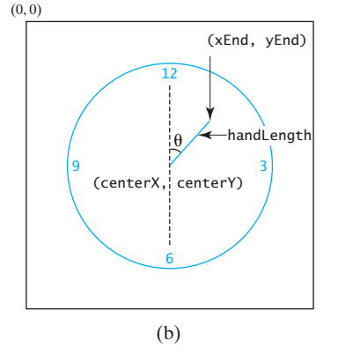
Use the ClockPane Class
(a) The DisplayClock program displays a clock that shows the current time. (b) The endpoint of a clock hand can be determined, given the spanning angle, the hand length, and the center point.
endX = centerX + handLength × sin(θ)
endY = centerY - handLength × cos(θ)
DisplayClock
Run

Slide 80
Use the ClockPane Class (cont.)
Since there are 60 seconds in one minute, the angle for the second hand is:
θ = second × (2π/60)
Since there are 60 minutes in one hour, the angle for the minute hand is:
θ = minute × (2π/60)
Since one circle is divided into 12 hours, the angle for the hour hand is:
θ = (hour + minute/60) × (2π/12)

